Slide 1
Customer Intelligence & Marketing Campaign Analysis
Python | Machine Learning | Statistical Analysis| Power BI
Presented By
Rajeshwari Patel
Data Analyst

Slide 2
Business Problem
Objective Analyse customer behaviour and campaign performance to identify high-value customers and improve marketing effectiveness. Business Questions Who are the most valuable customers? Which products drive revenue? Which customers respond to campaigns? How can marketing ROI be improved?

Slide 3
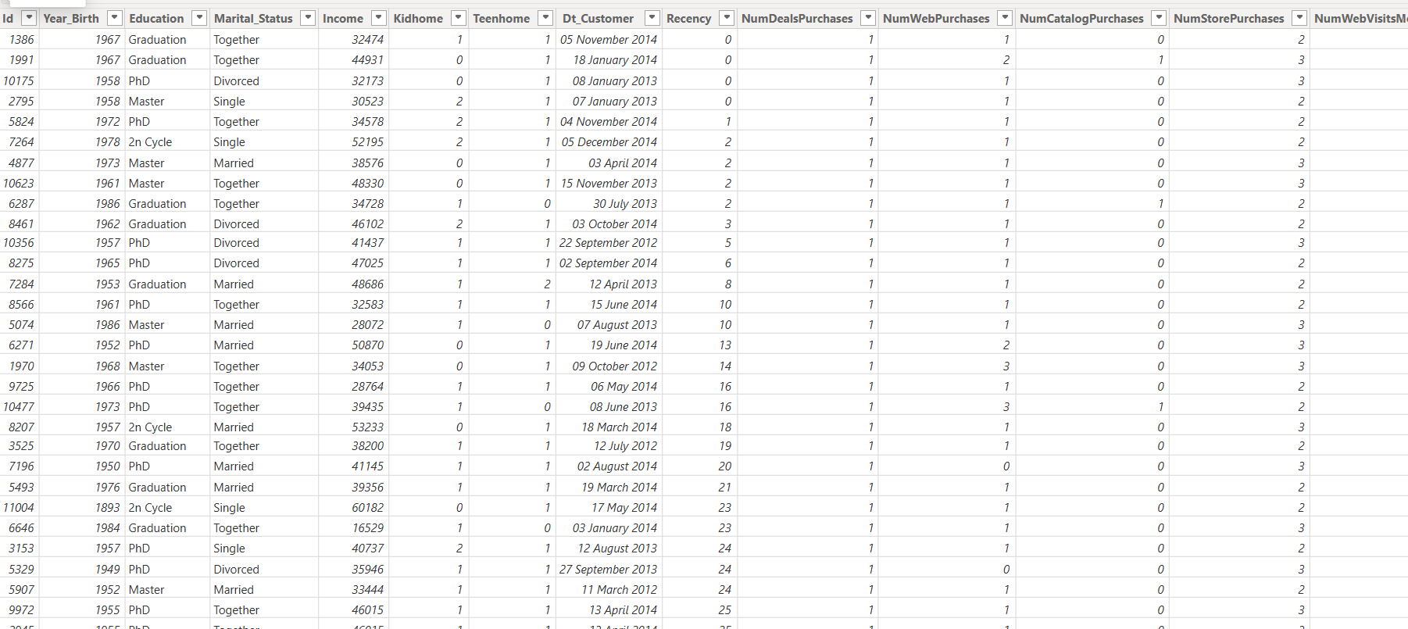
Dataset Overview
Total Customers: 2240
Customer Demographics
Product Purchases
Campaign Response
Income Information
Purchase Channels

Slide 4
Data Preparation
Data Cleaning
Missing values handled
Outliers treated
Feature Engineering
Age
Family Size
Total Spend
Total Engagement
Income Group
RFM Metrics

Slide 5
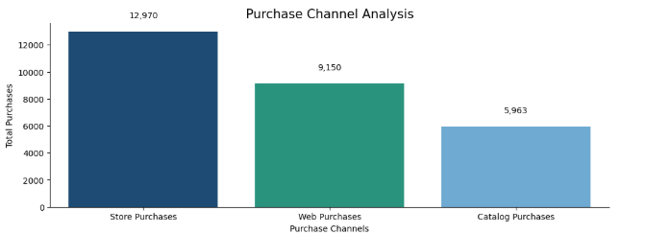
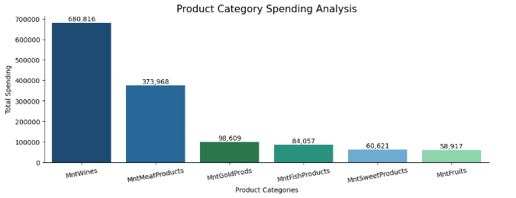
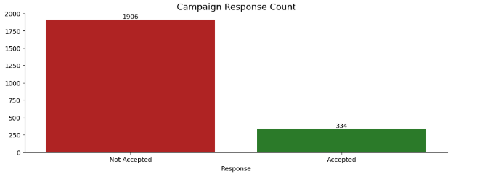
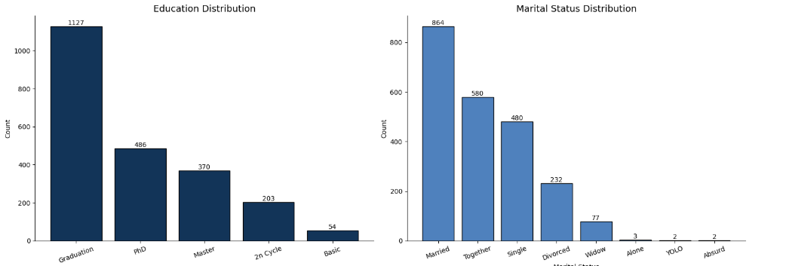
Exploratory Data Analysis

Slide 6
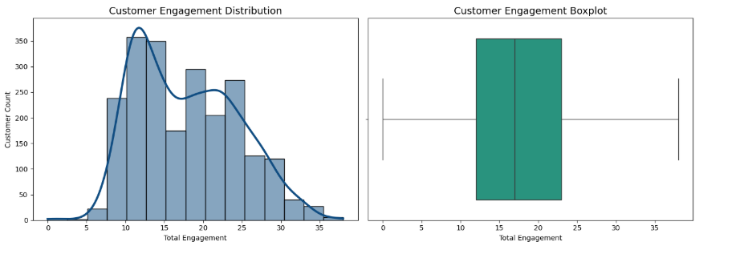
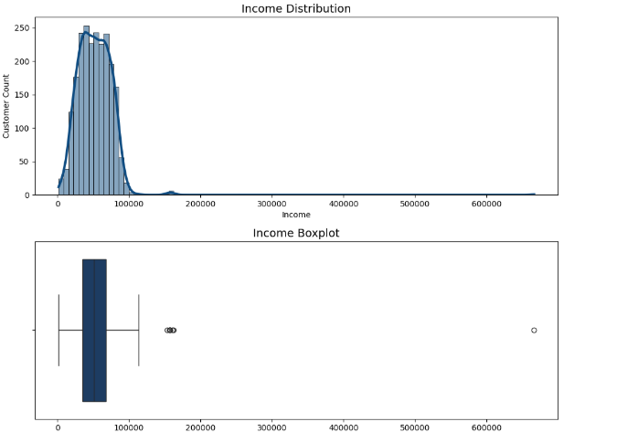
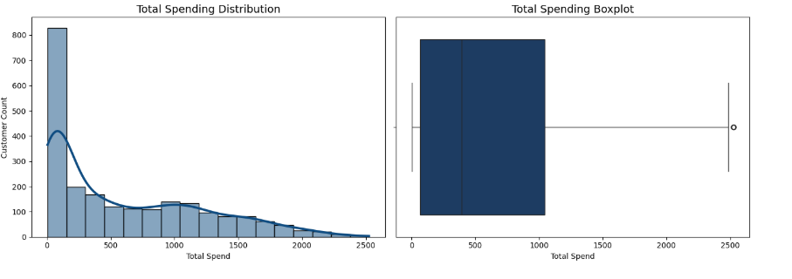
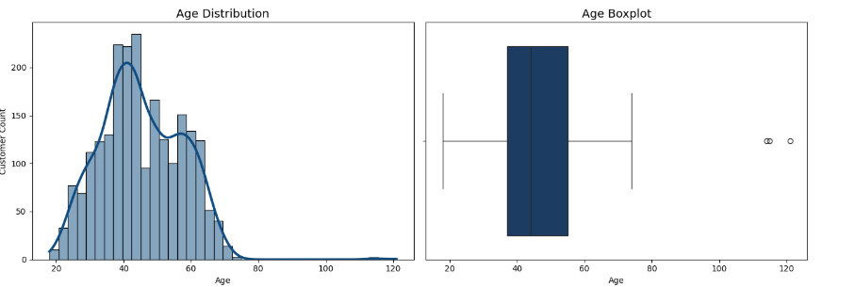

Slide 7
Key Findings
Wines generated highest revenue.
Store purchases dominated transactions.
High-income customers spent more.

Slide 8
Statistical Analysis
Pearson Correlation Test
Income vs Total Spend
Result:
Positive Correlation
Statistically Significant
Chi-Square Test
Customer characteristics and campaign response showed significant relationships.
T-Test
Customer groups exhibited differences in spending behaviour.

Slide 9
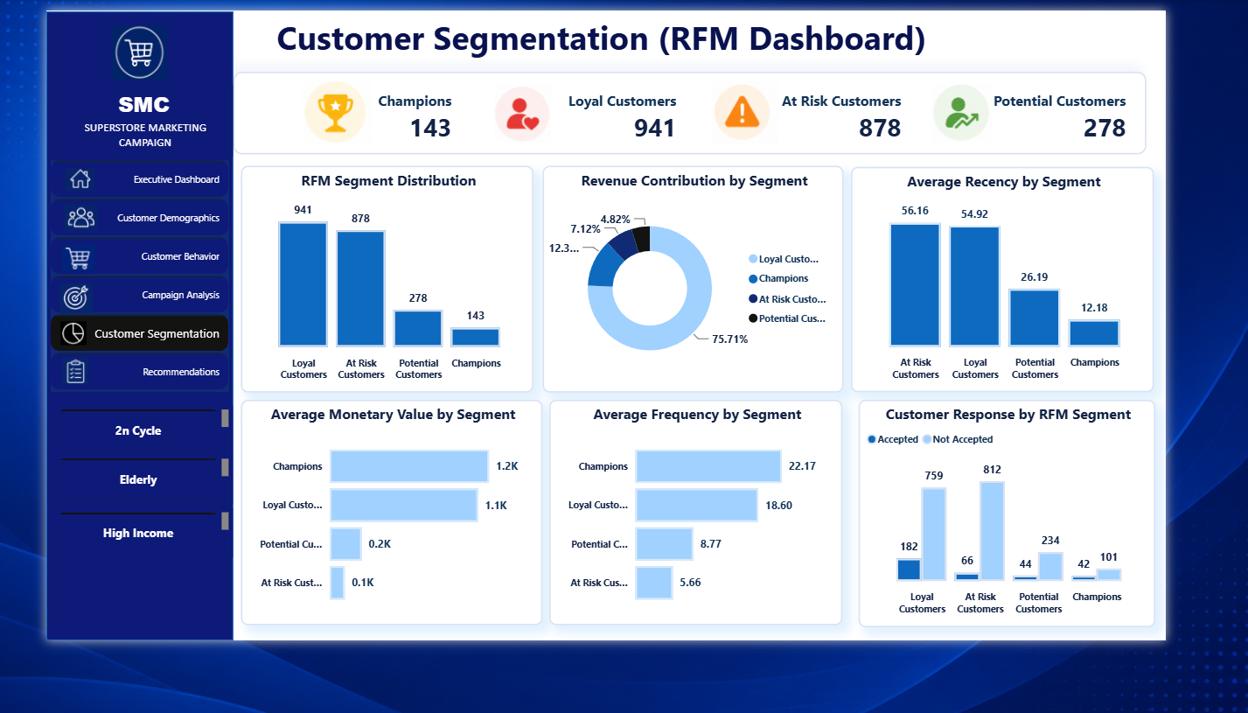
Customer Segmentation (RFM)
Champions and Loyal Customers contribute the highest value.

Slide 10
Machine Learning Model Logistic Regression
Objective: Predict customer campaign response.
Features
Income
Age
Spending
Engagement
Frequency
Recency
Accuracy Score : 83.48 %

Slide 11
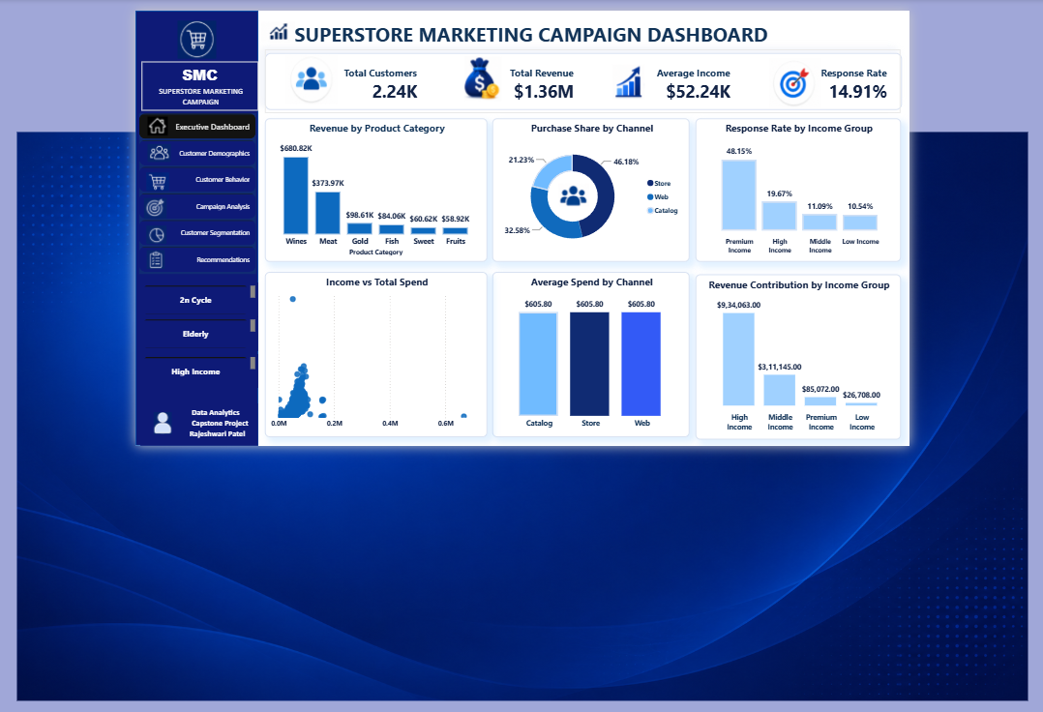
Power BI Dashboard

Slide 12
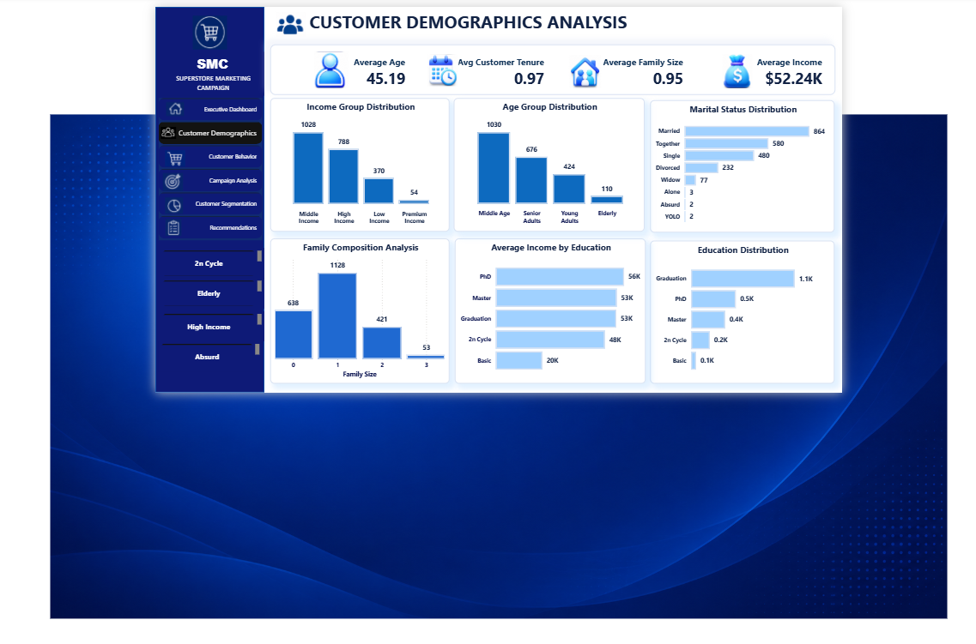

Slide 13
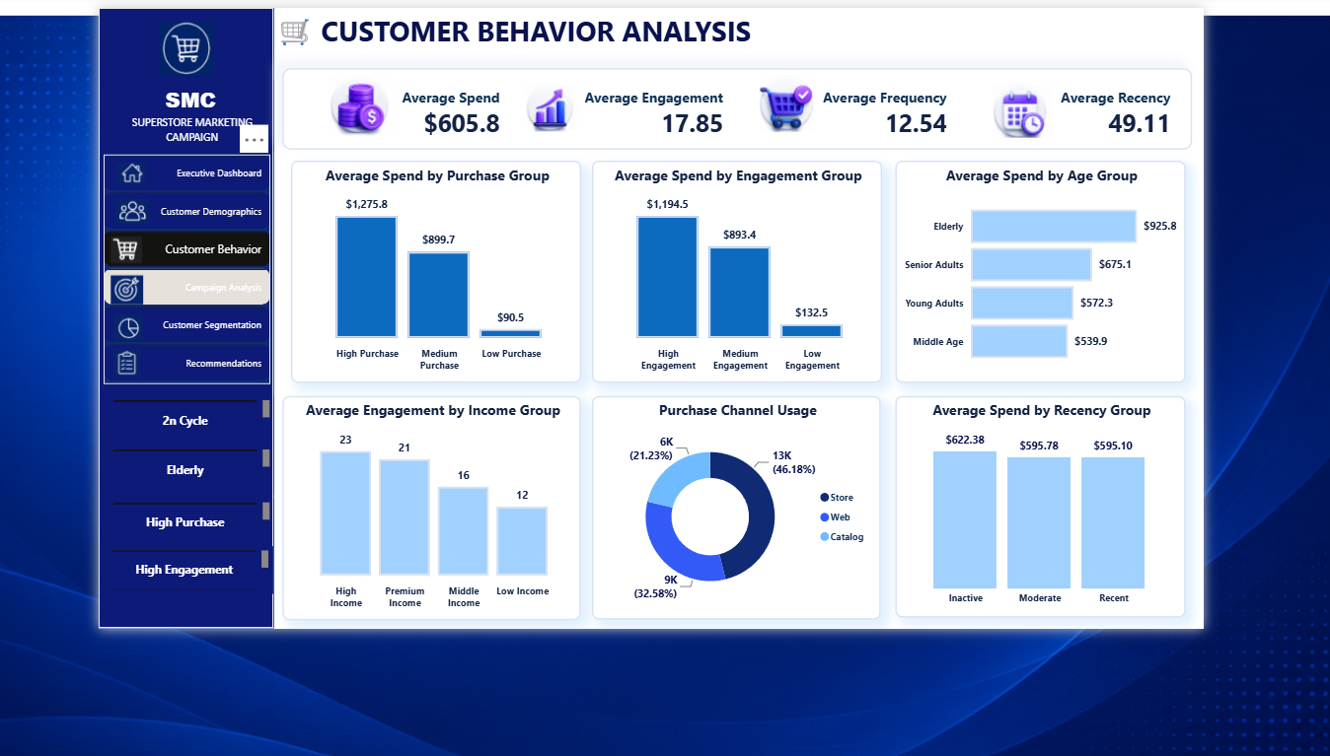

Slide 14
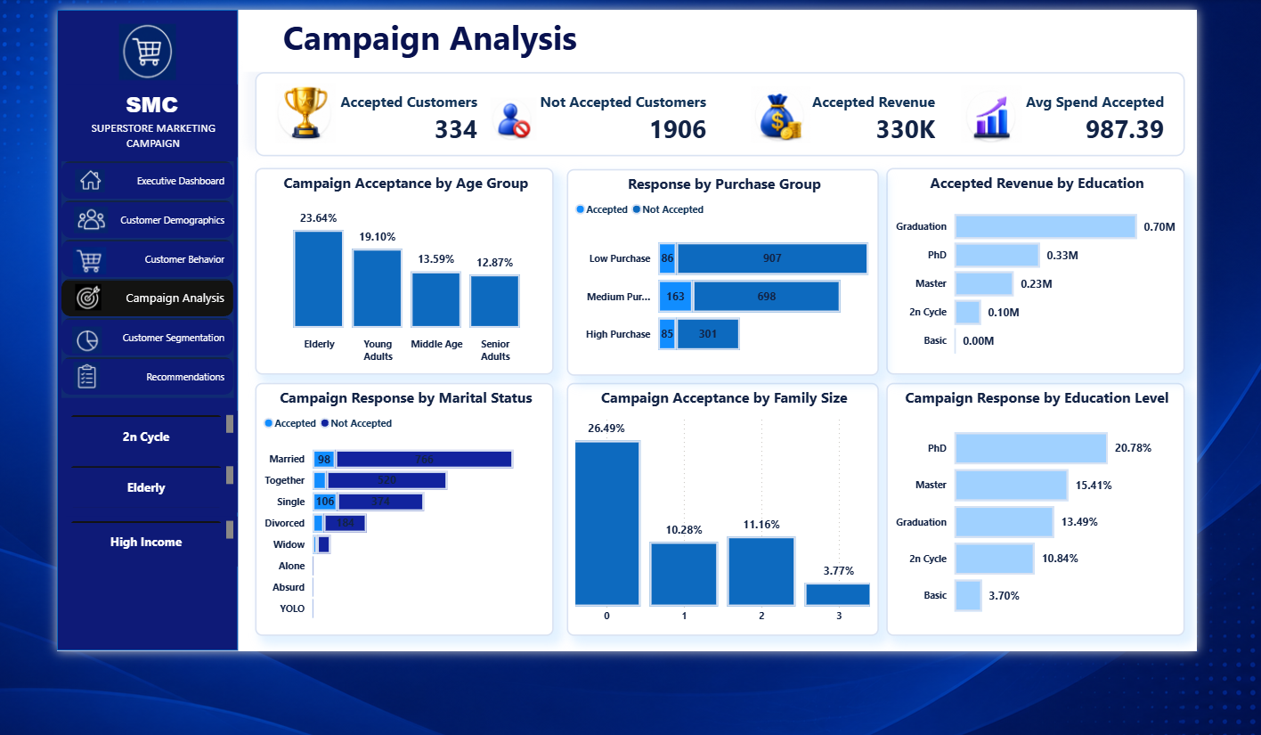

Slide 15
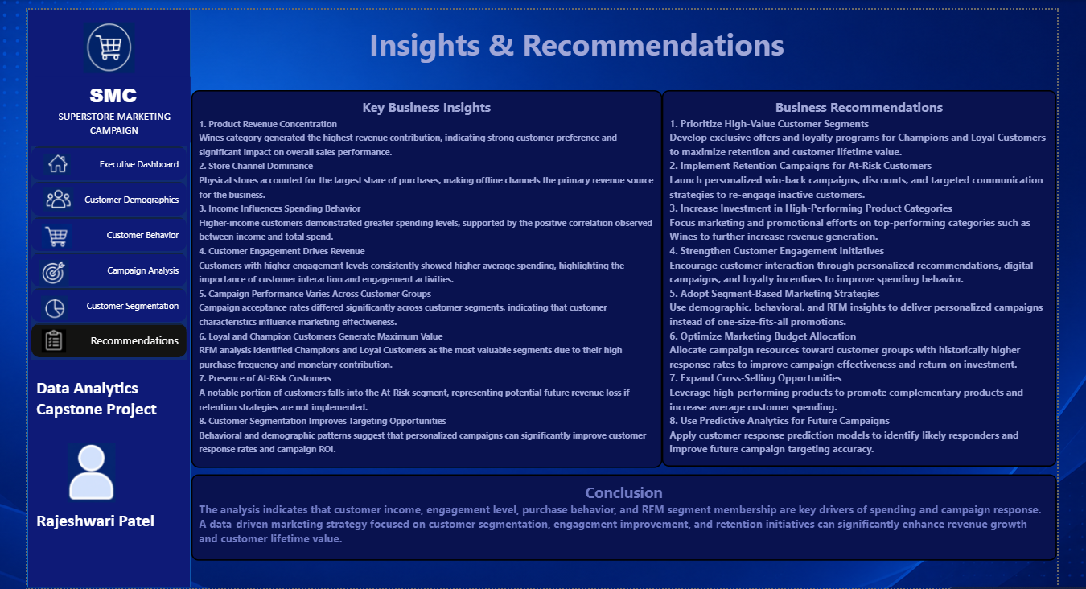

Slide 16
Insights & Recommendations
Insights
High-income customers spend more.
Customer engagement increases spending.
Wines are the top revenue category.
Champions and Loyal Customers generate maximum value.
At-Risk customers require retention efforts.
Recommendations
Focus on high-value segments.
Improve customer retention.
Increase customer engagement.
Use targeted marketing campaigns.
Apply predictive analytics for future campaigns.

Slide 17
Thank You
Questions & Discussion
Customer Intelligence & Marketing Campaign Analysis
Prepared By
Rajeshwari Patel
Python | Machine Learning | Power BI |Statistical Analysis

